Slide 1
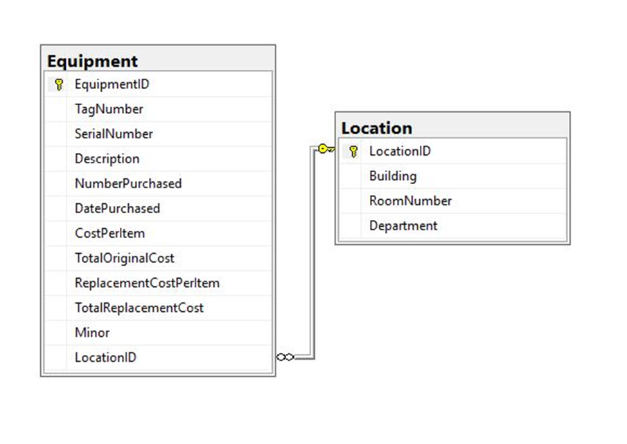
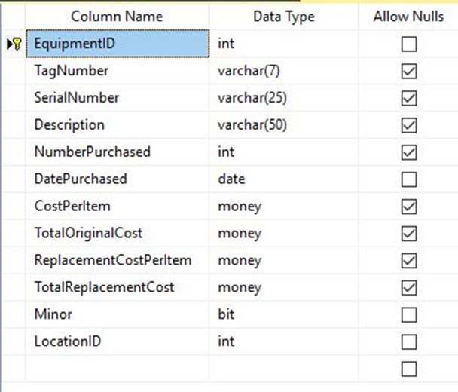
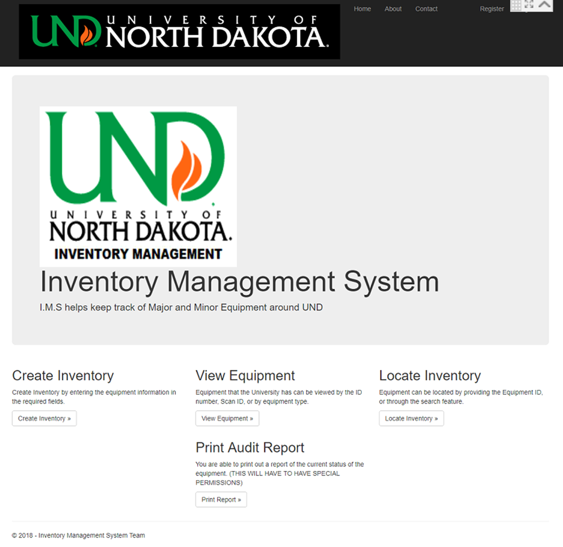
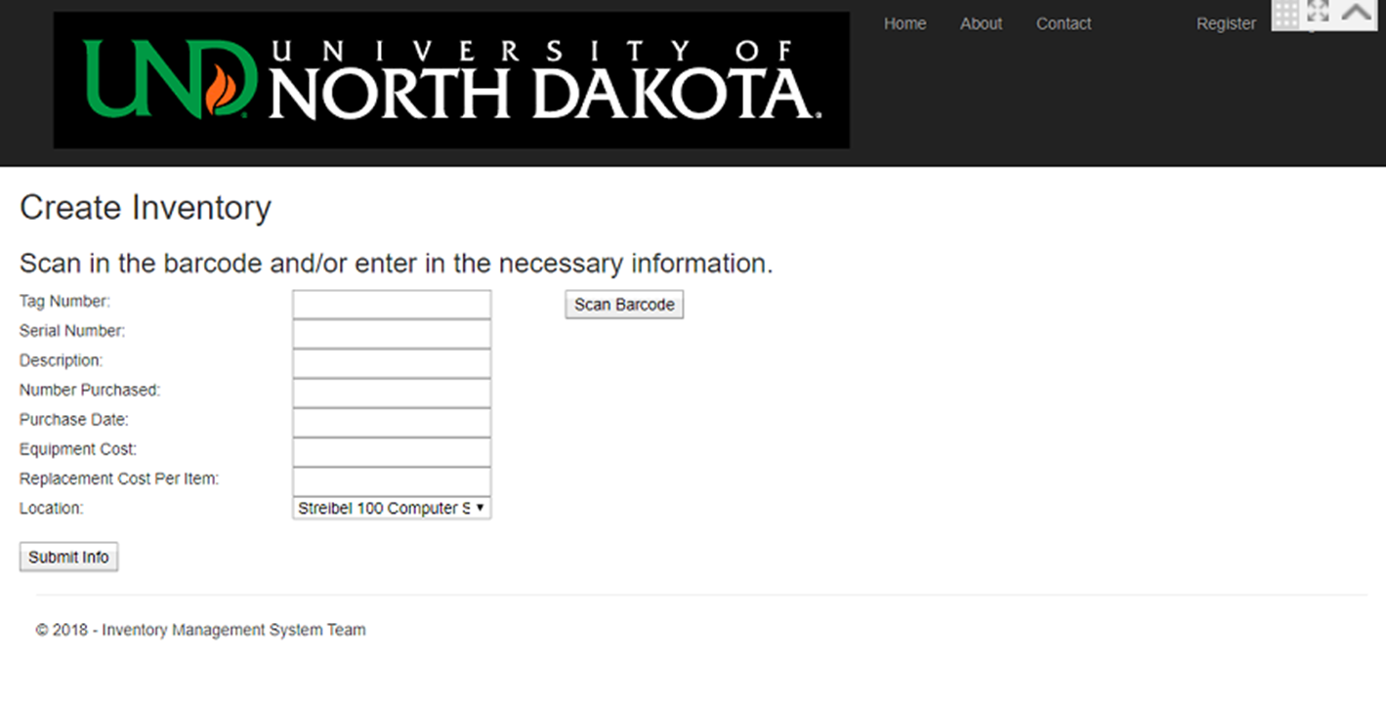
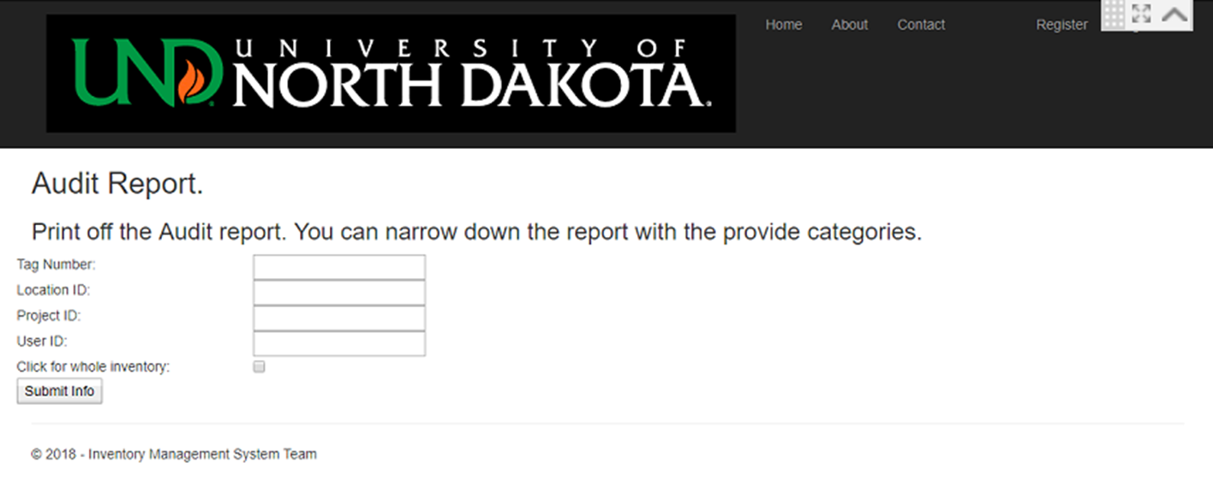
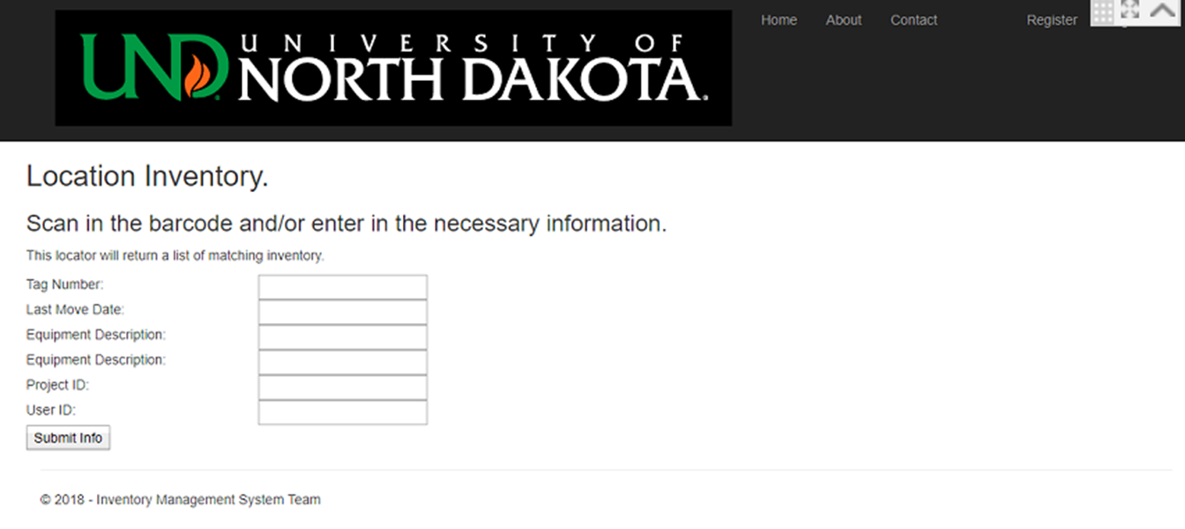
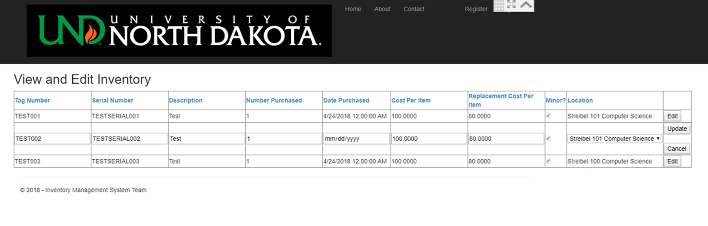
Developing A Web and Mobile Based Inventory Management System in ASP.NET
Students: August Davis, David Erickson, Christian Hanson
Advisors: Emanuel Grant
Scanner:
On android scanning is handled by a call to the external app “XZing Barcode Scanner”
On PC scanning is handled by a USB hand scanner
No scanning available on non android phones
Database Diagrams
Project Goals
Ability to scan barcodes of new inventory from a cellphone camera
Organize inventory information in a format that will allow for easy viewing, editing and auditing
Have an easy to use interface
Comprehensive documentation for future developers of the project
Interface Pages
Database:
Microsoft SQL Server is used for storage
Interface:
Made using Asp.net frame work
Designed to work on mobile
Complies with UND design standards
Allows for easy navigation between features via navigation bar
Prepping for Future Development:
Set up scripts and explanation documents have been written for database set up.
Most the code pages have explanation headers and further explanation comments

